Slide 1
Kazakh Aliexpress!
CSSE-1803 Murat Dalen.

Slide 2
What is the theme of my project?
The topic of my project this semester was Kazakhstan Aliexpress. My project provides an opportunity to register on the site in order to make purchases on it, since without registration, a site visitor can only look and search for goods on the site, and with registration, each client has his own basket to which he can add and remove from her different products, and then make a total purchase for the total amount of all the products in the shopping cart of the customer (registered).

Slide 3
Description of project.
Well, the main features of my project are the ability to quickly buy and add items you like to the cart, as well as search for individual products in separate product sections, for example, a separate search for equipment, a separate search for things, etc. Also, visitors who want to register on the site will have to leave information about themselves so that we know where to deliver the goods or how to contact the buyer in case of problems with delivery or purchase.

Slide 4
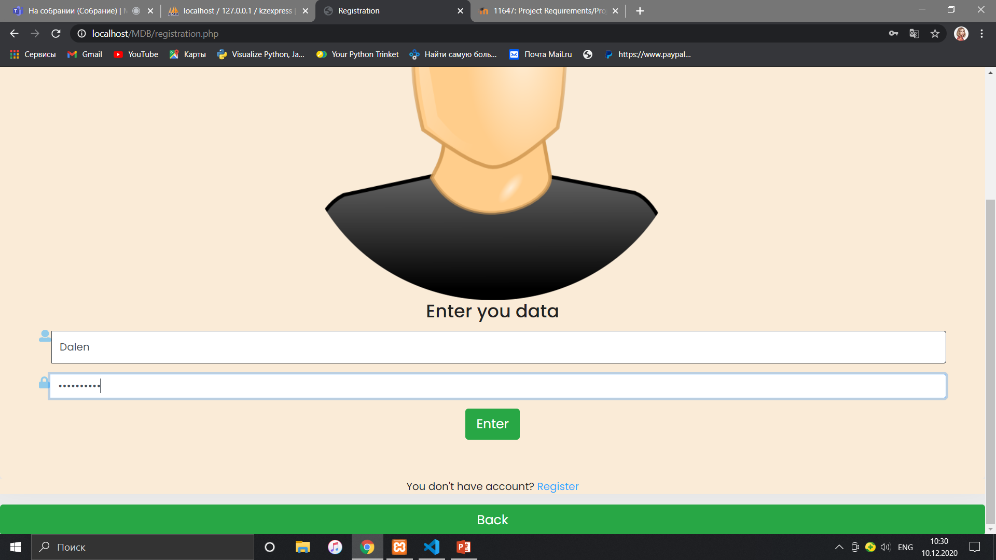
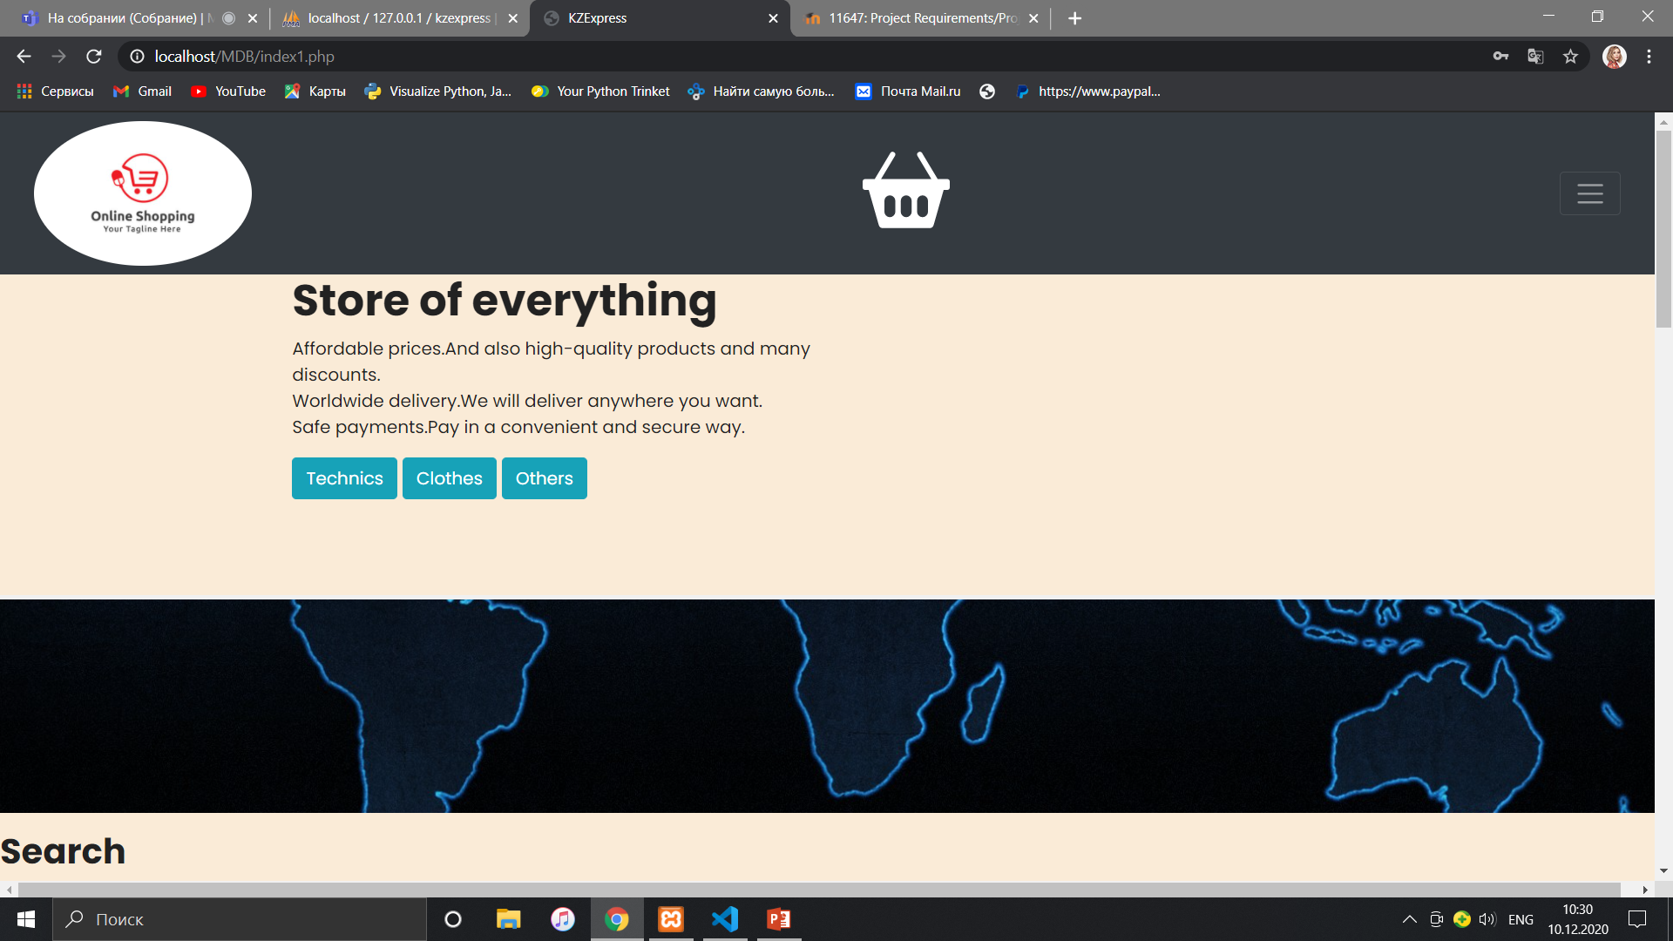

Slide 5
About admin panel.
Also, my project implies the presence of one admin, who, after registering in the admin panel, has the right to change, delete, add products of all subdivisions, and the admin has the right to display a list of all store products from the sorting.
When the admin adds a new product, changes it or deletes it, these changes take place immediately in the site itself, thanks to the connection with the SQL database, thus, in my project, the person who deals with all the products on the site is the admin.

Slide 6
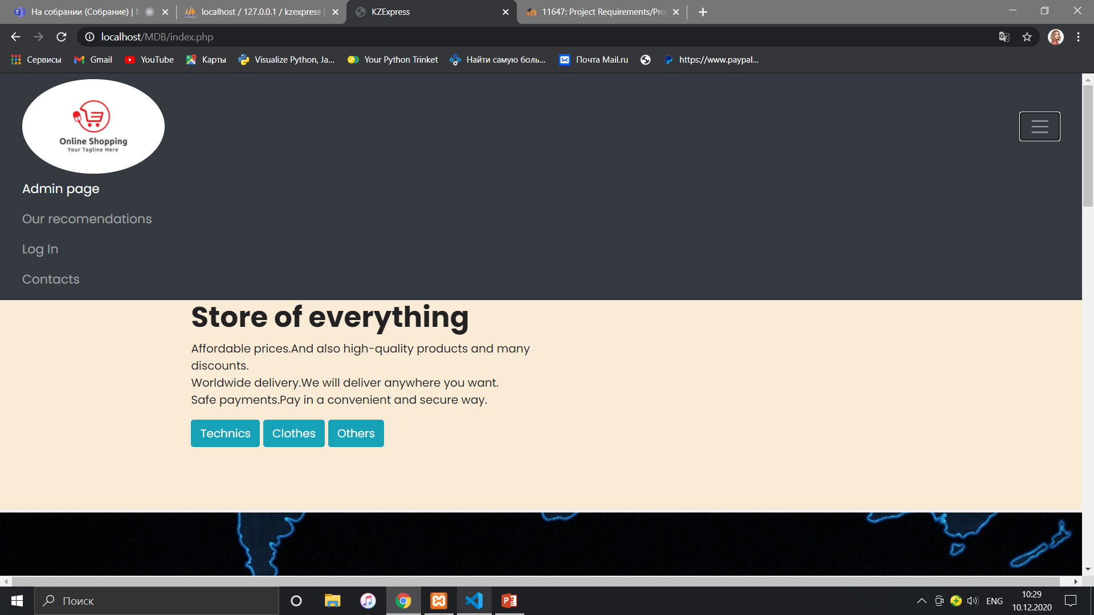
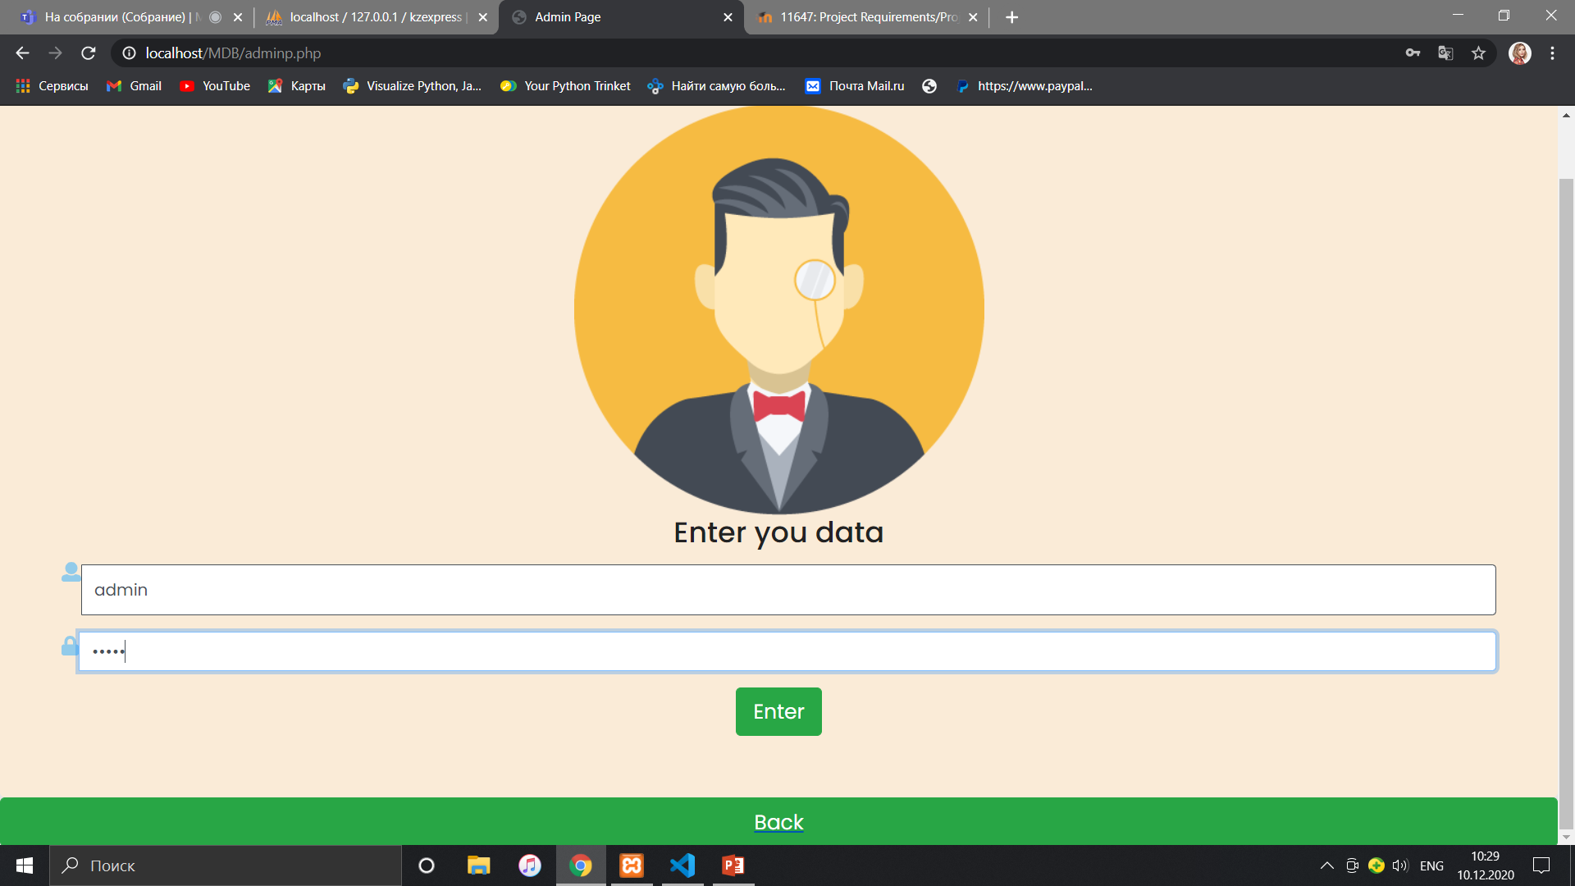

Slide 7
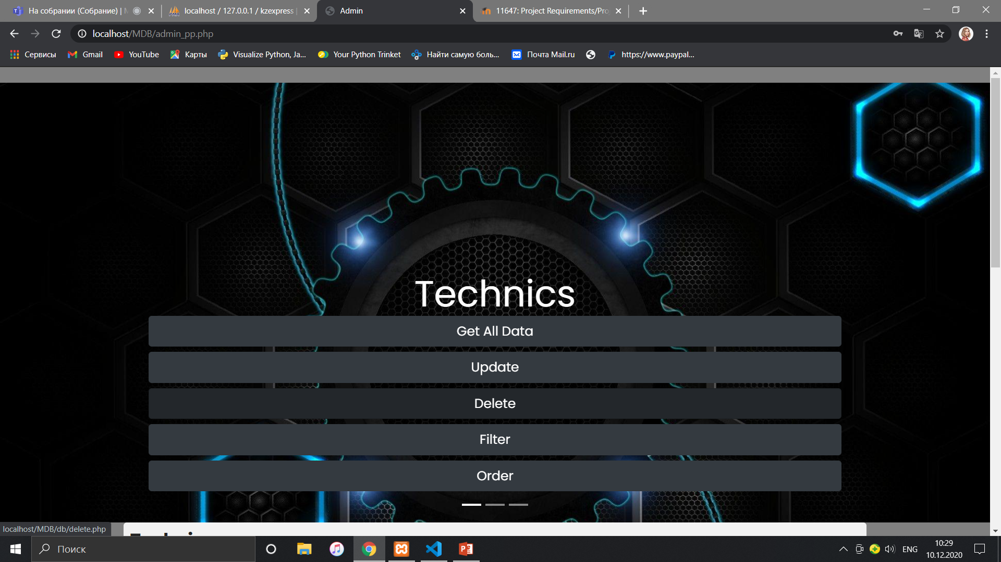
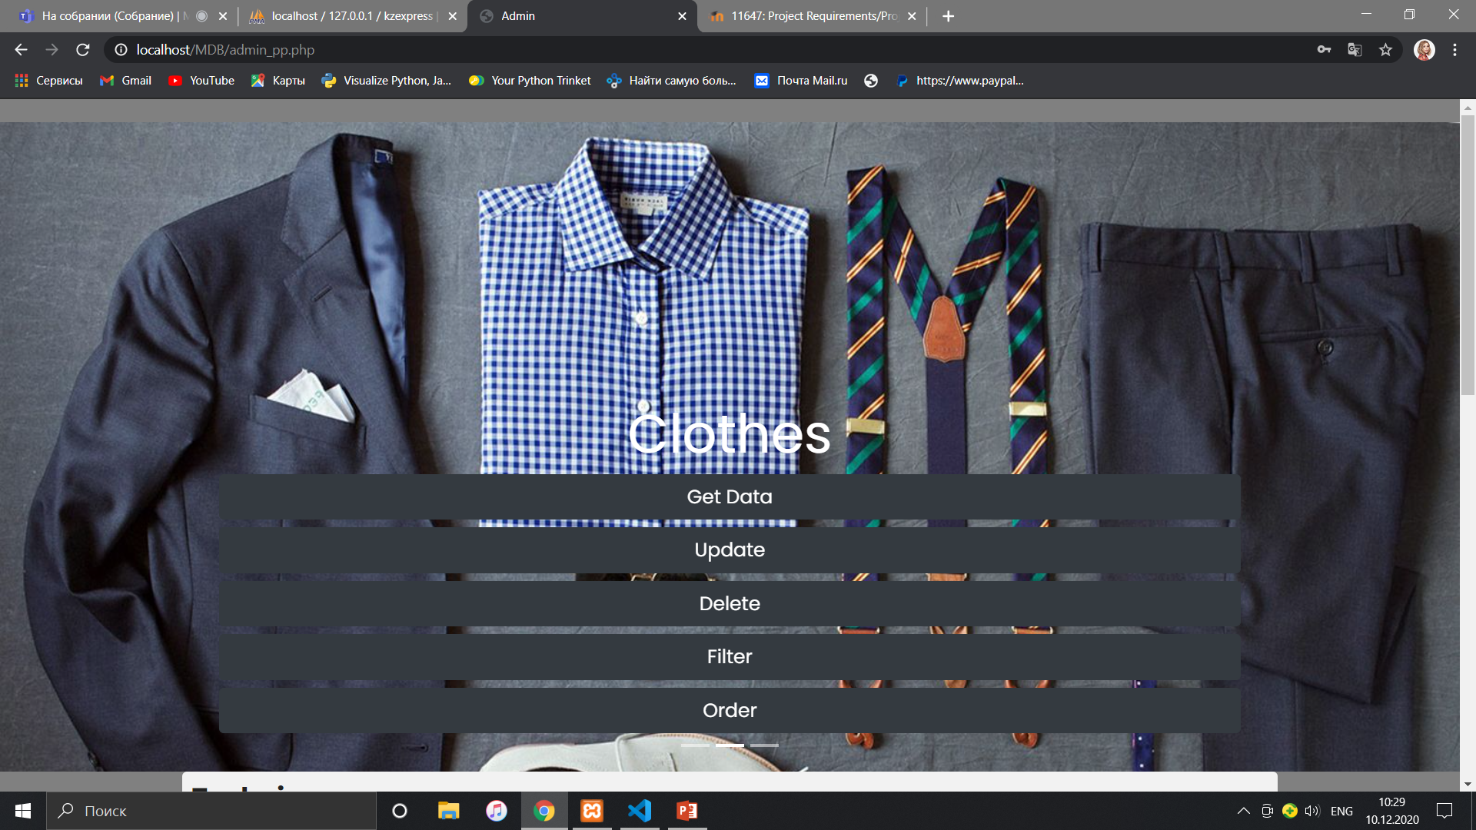

Slide 8
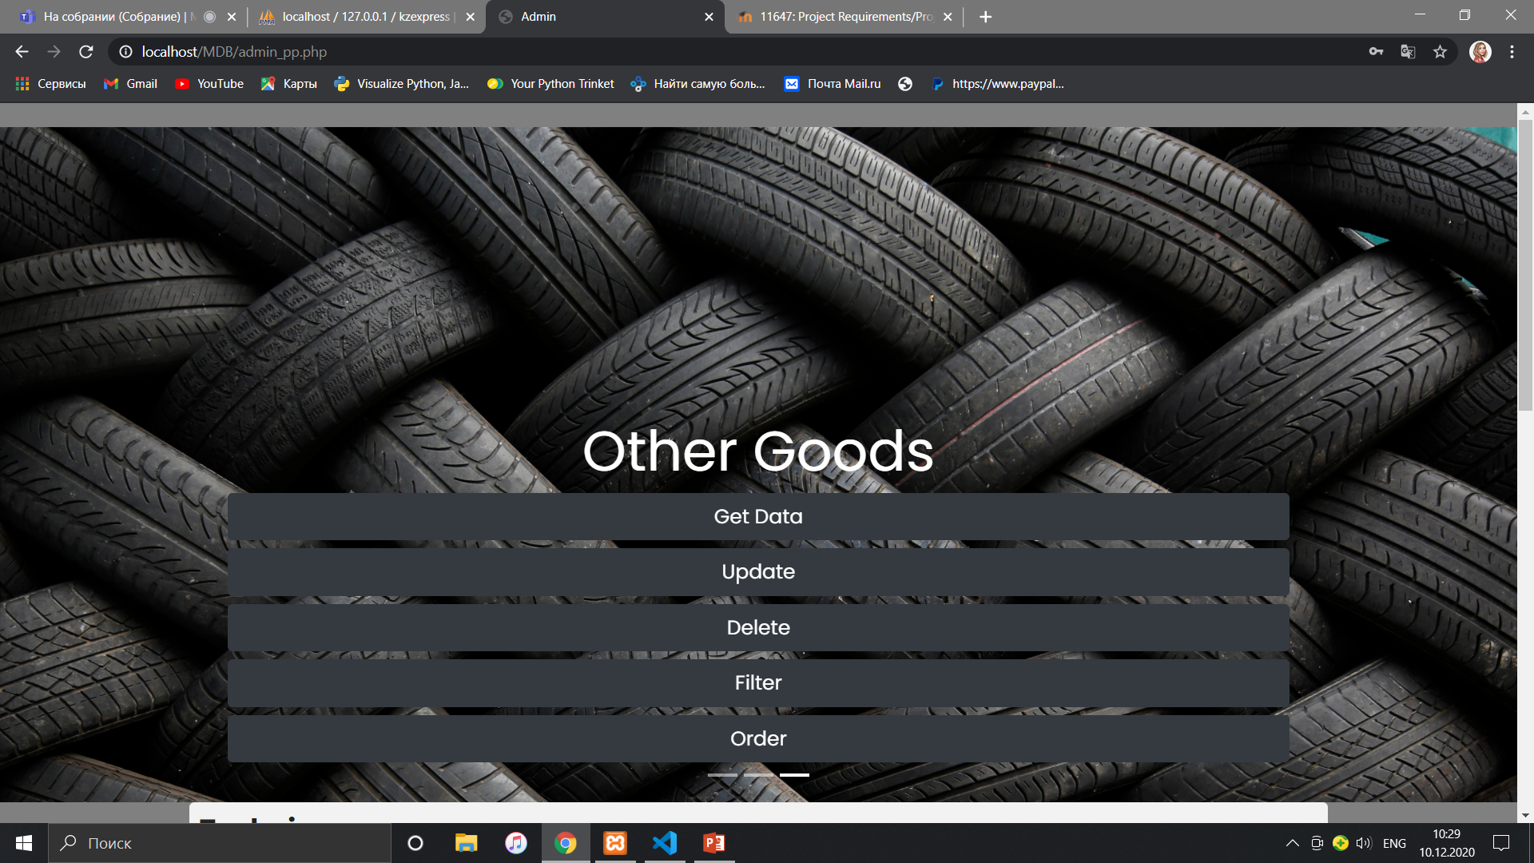
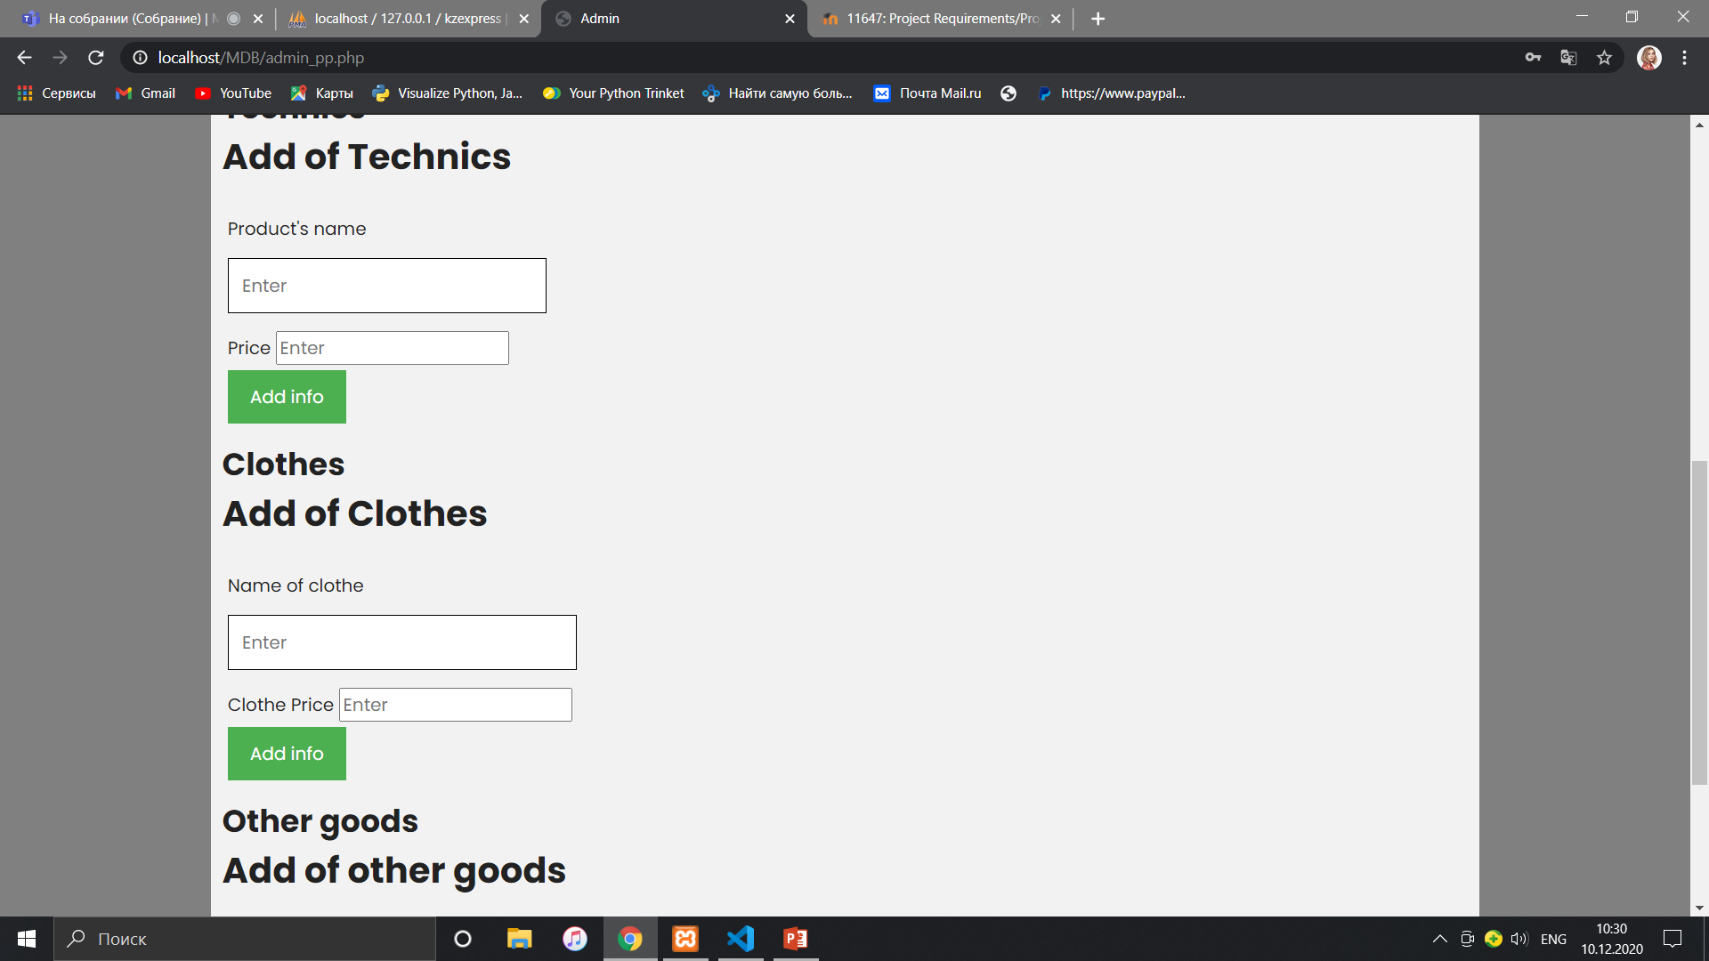

Slide 9
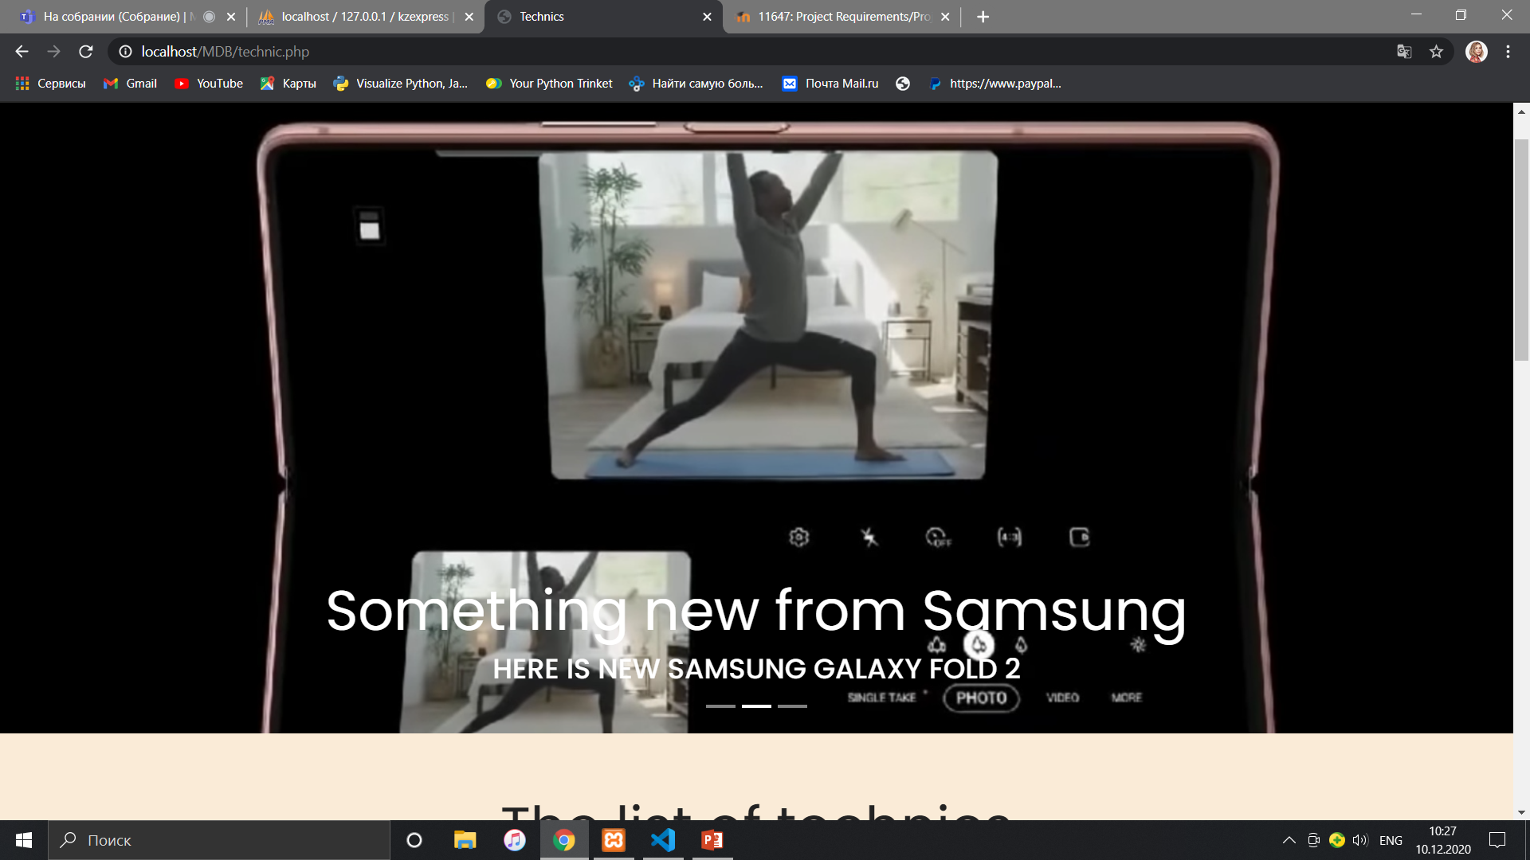
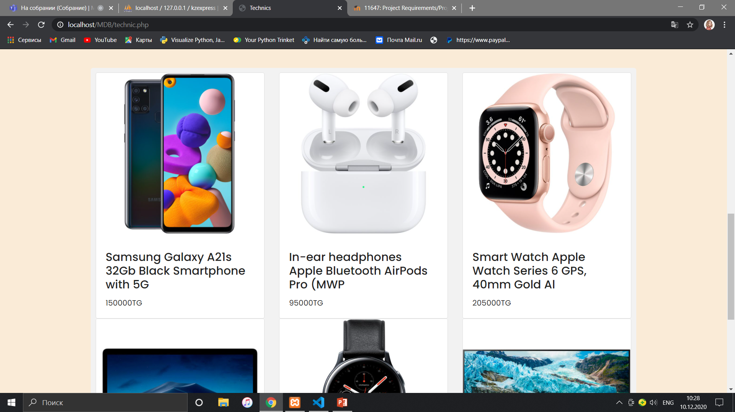

Slide 10
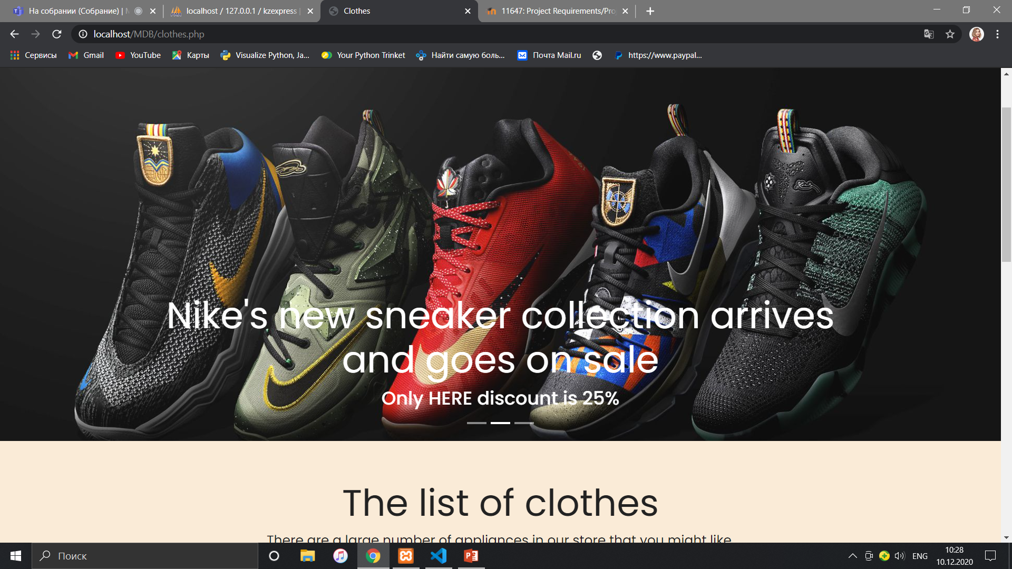
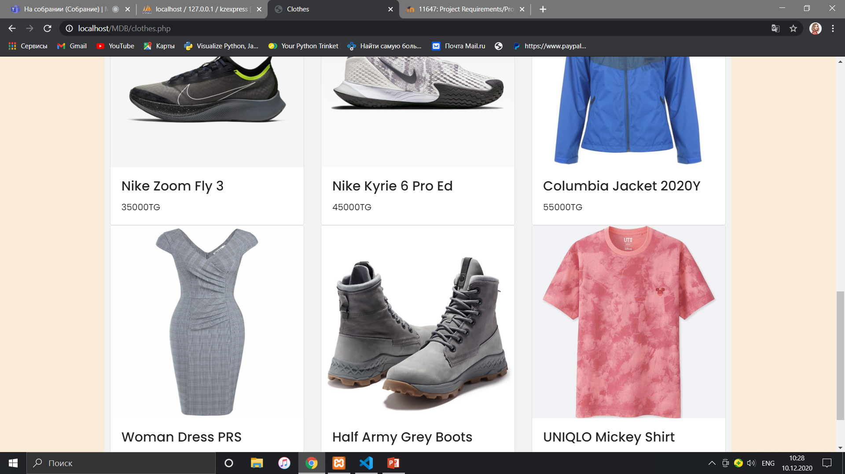

Slide 11
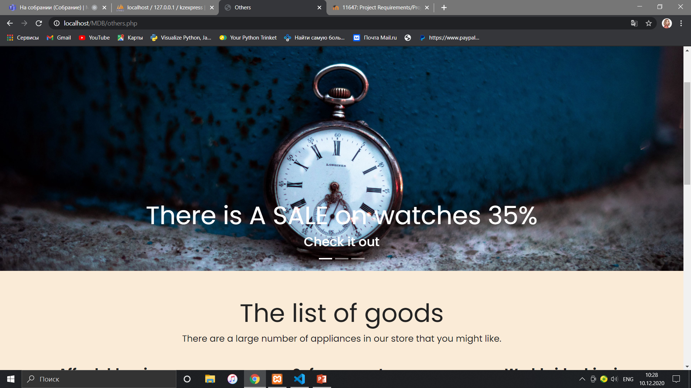
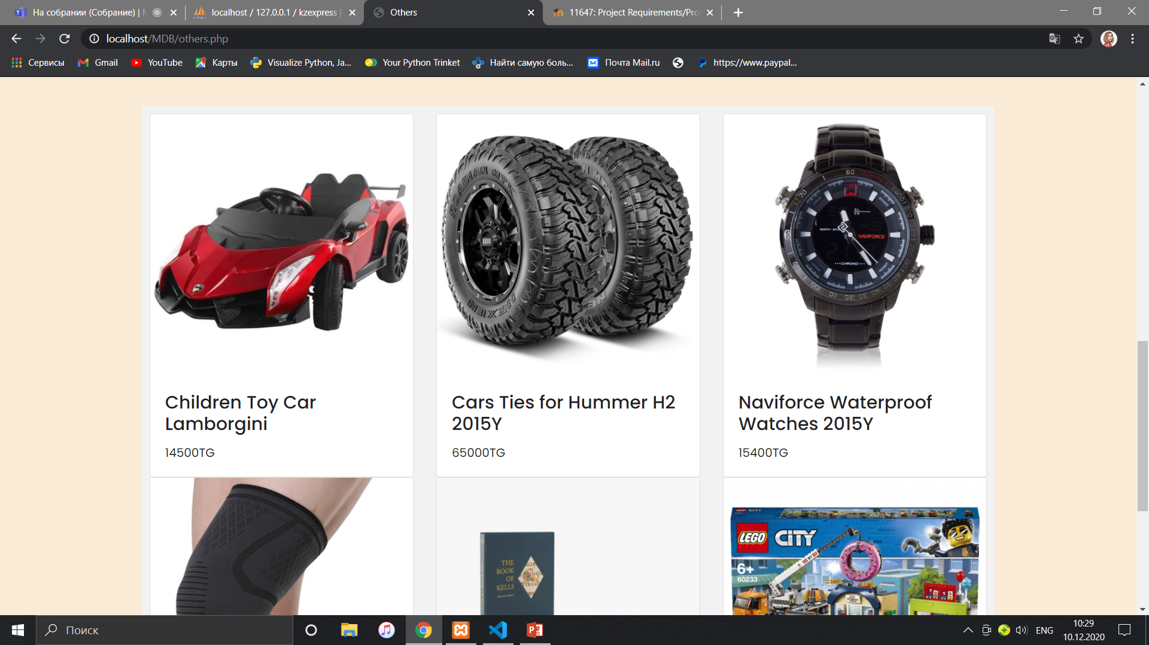

Slide 12
About basket.
The main task of my project was to create a convenient, fast and modern system for purchasing various goods on the website. In my project, this purchase system is presented, through the customer adding goods to the general basket of each client and then purchasing them in the same basket window (just below the list of basket goods).

Slide 13
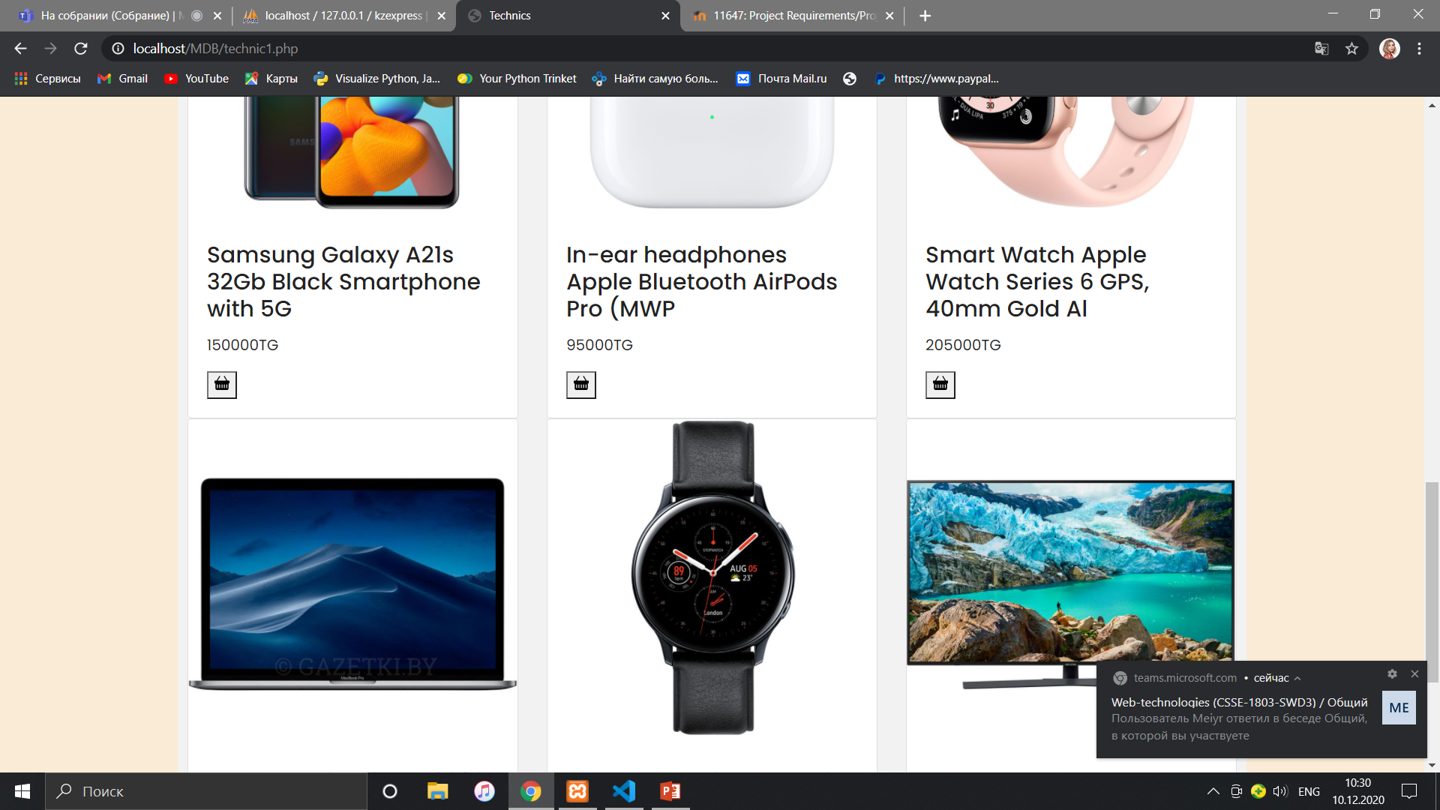
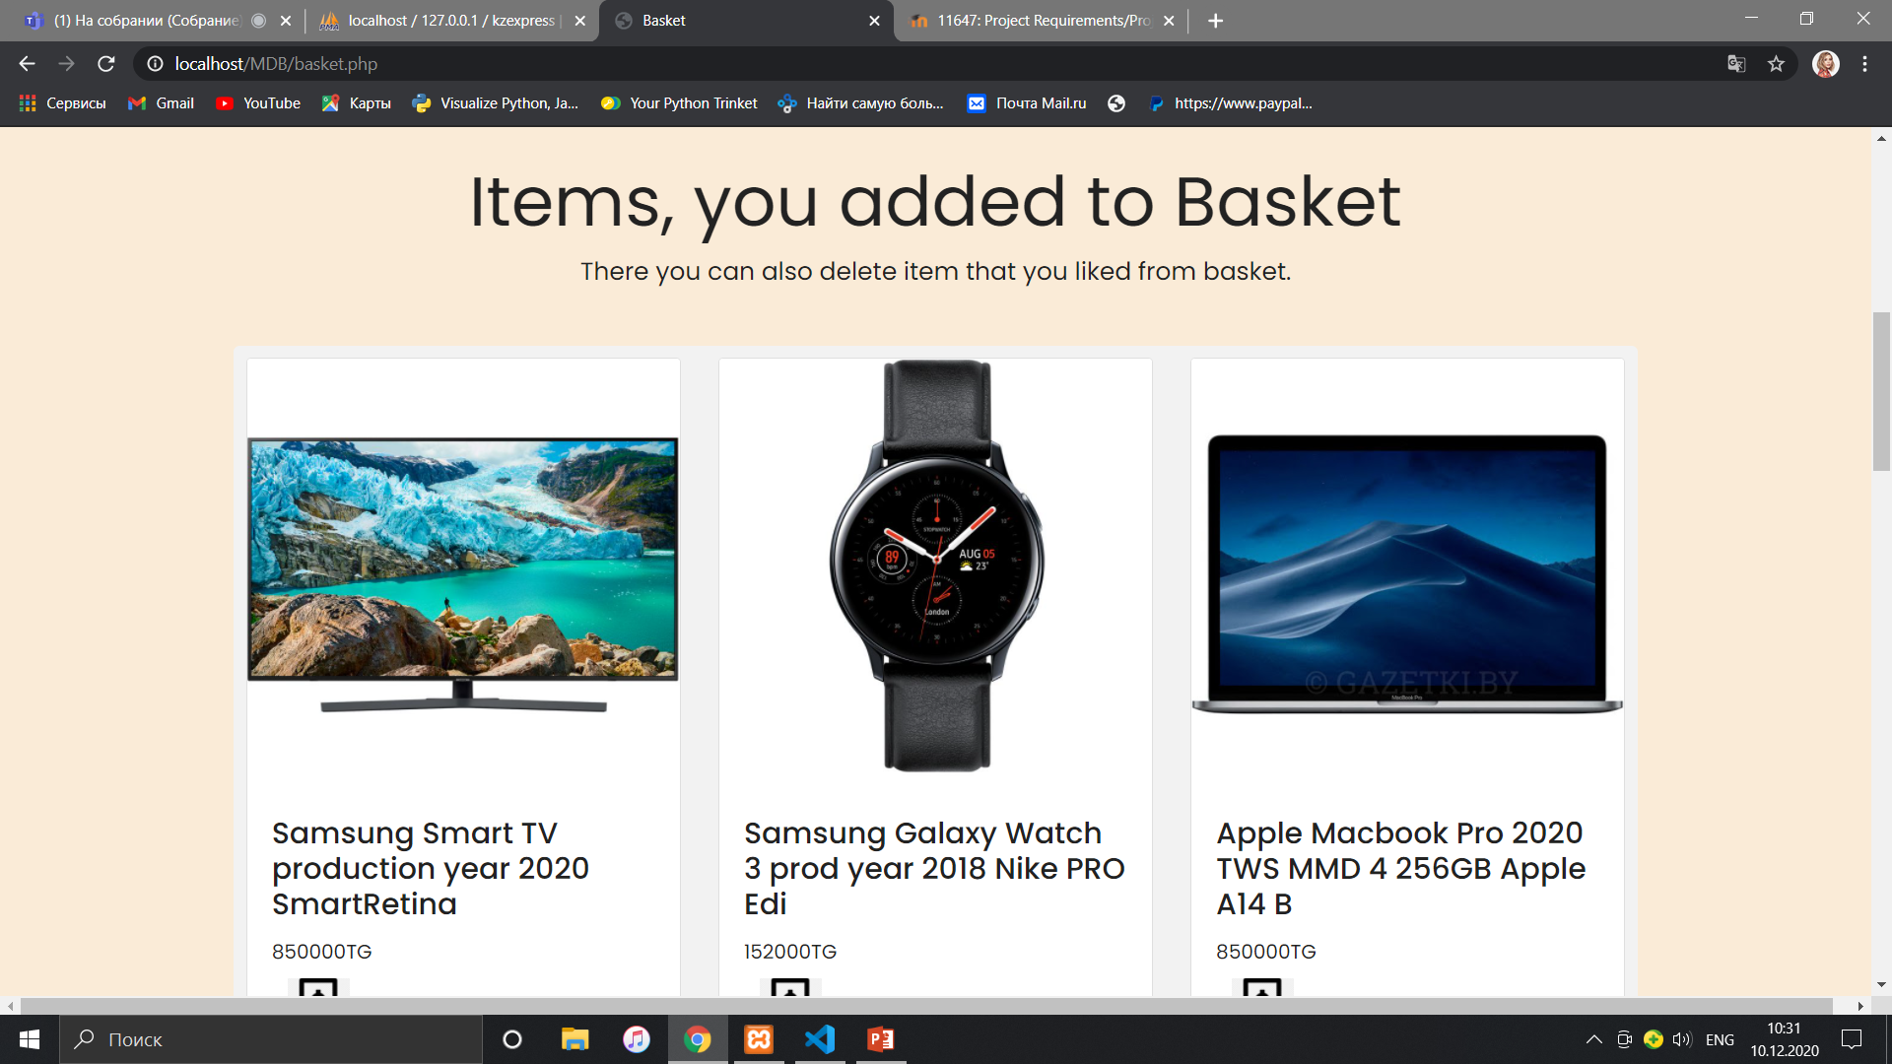

Slide 14
